Slide 1


Day: 11 Describing Document Types and Posting Levels
Document types, posting levels, and Posting in Group Journal

Slide 2
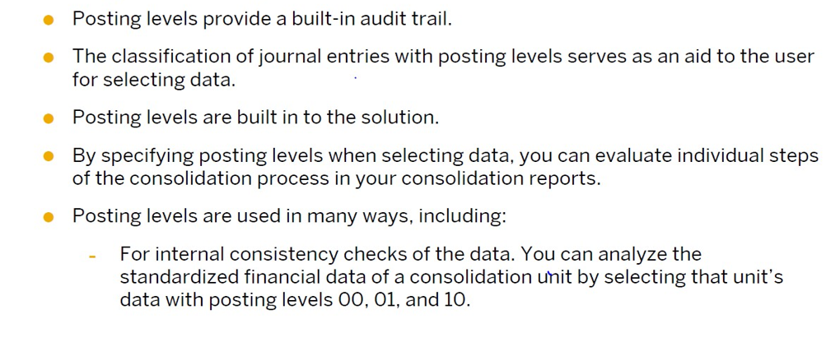
Posting level Key Points

Slide 3
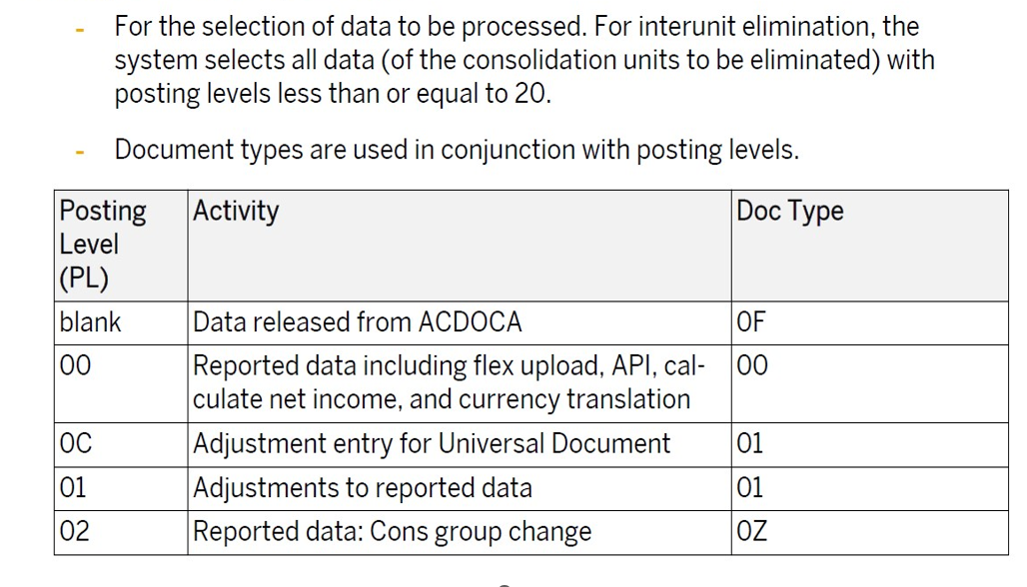
Posting level Key Points

Slide 4
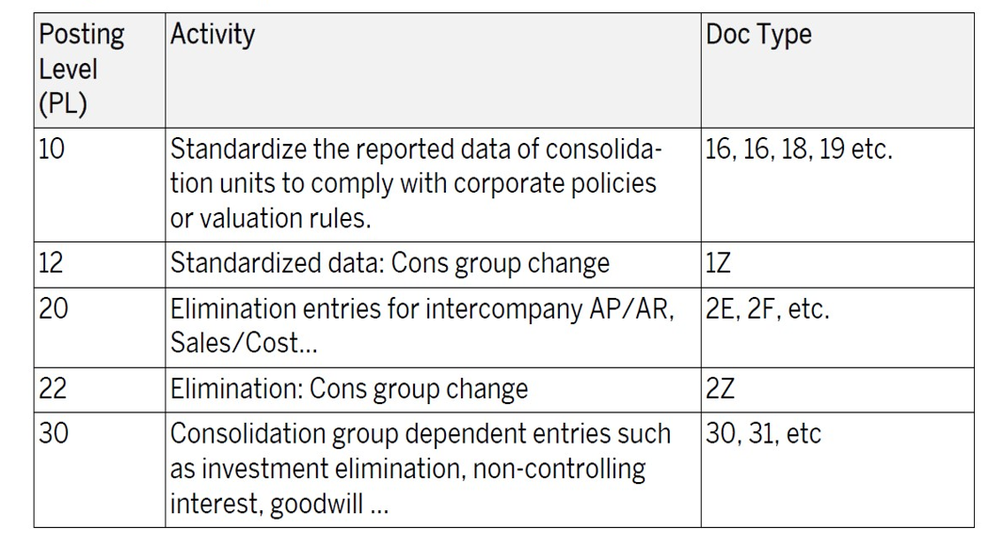
Posting level Key Points

